Slide 1
Count data
SSA 200 – Day 1 – Lecture 4

Slide 2
Presence/absence data vs. abundance data
Example 1: A researcher conducts point counts for birds in the same forest plot each summer. During point counts, they make an effort to detect and record every species and count the individuals within the survey window.
Example 2: A National Park office often gets reports from people who have seen wolverines in the park. They keep track of the locations and dates of these sights and they send two temp interns to set-up and camera traps randomly throughout the park to capture wolverine on tape.
Example 3: A natural history museum has plant specimens that contain information about the location and date of collection, which can be used to map historical occurrence of the species. Associated field notebooks record the number of total unique plants along the same paths each year for 25 years.

Slide 3
Abundance data
When we have information at repeated places over repeated time periods
camera traps
hair/eDNA traps (unique individuals over time)
transect surveys
distance sampling
What else can you think of?

Slide 4
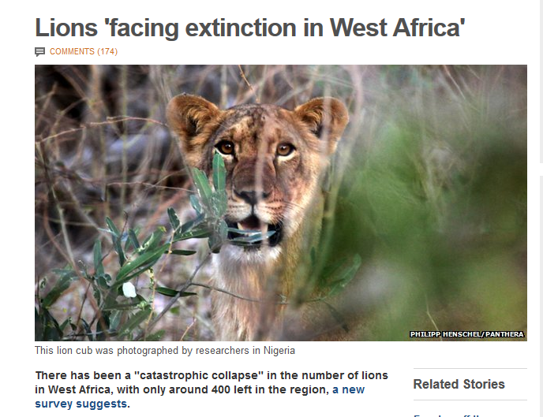
It is difficult to estimate the abundance of animals….yet, we try.
~400

Slide 5
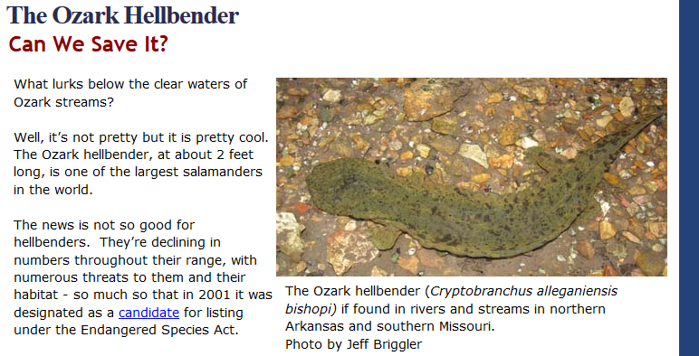
It is difficult to estimate the abundance of animals….yet, we try.
~400
~590

Slide 6

It is difficult to estimate the abundance of animals….yet, we try.
~7600

Slide 7
Common analytical approaches
Poisson GLM
N-mixture models

Slide 8
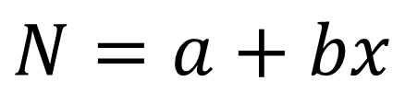
Poisson GLM
Generalized linear model (GLM)
Poisson distribution
$$N=a+bx$$
Frequency
Environmental/ecological covariates
Abundance
Notes:
Add Overview of poisson glm

Slide 9
GLM extensions
Can account for lots of 0 counts in data with different statistical distributions
Negative binomial
Zero-inflated Poisson
Notes:
Add Overview of poisson glm

Slide 10
GLM assumptions
Count data reasonably follow the Poisson distribution
Perfect detection of individuals
Counts = censuses of all animals present
Notes:
Add Overview of poisson glm

Slide 11
Two issues with abundance estimates:
Detectability
Spatial indexing

Slide 12
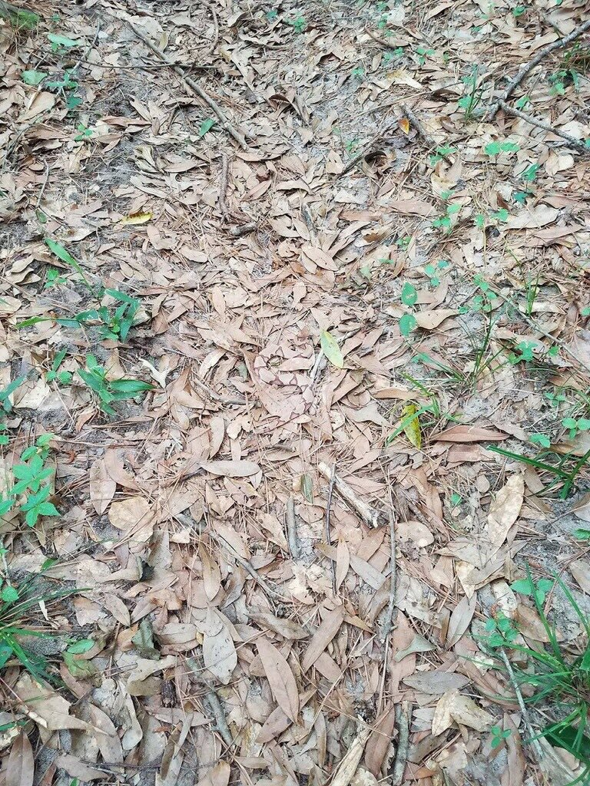
Two issues with abundance estimates:
Detectability

Slide 13

Two issues with abundance estimates:
Detectability
6,925 Retweets
23,876 Likes

Slide 14
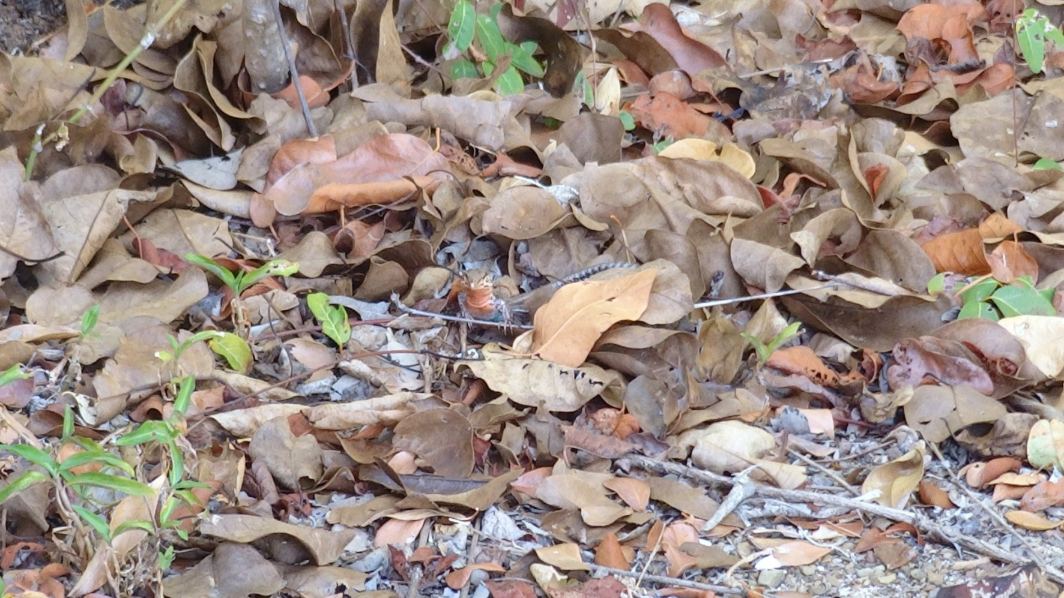

Issue 1: Detectability
Availability
Detection
Intra-specific variation
Mackenzie et al 2002. Estimating site occupancy rates when detection probabilities are less than one. Ecology
Notes:
Discuss these three (and other) types of observation processes
Estimating site occupancy rates when detection probabilities are less than one (Mackenzie, Nichols, Lachman, Droege, Royle, Langtimm. 2002. Ecology.)

Slide 15


Different patterns due to ecological patterns, behaviors, life history
Issue 2: Spatial indexing, i.e. spatial autocorrelation
Random Uniform Clustered
Notes:
Ponds, streams, forest edges, etc. all have different resources like mates and food that create different spatial patterns that influence detection processes.

Slide 16
N-mixture models solve both issues
Use repeated counts at several sites to estimate detection probability directly
Can include covariates associated with either abundance or detection
Explicitly model spatial and temporal variation
Called “mixture” because it combines two GLMs
Poisson GLM – abundance
Binomial GLM (Logistic regression) – detection
Notes:
AMT – removed equations

Slide 17
N-mixture model assumptions
Sites closed to immigration/emigration between surveys
Detection process is independent at each site, can vary among sites
These typically need to be addressed in the sampling design
Useful case study: St. Croix ground lizard

Slide 18
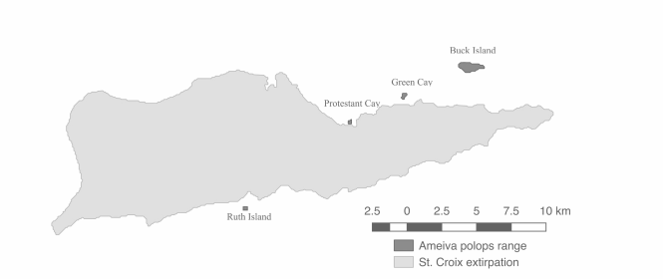
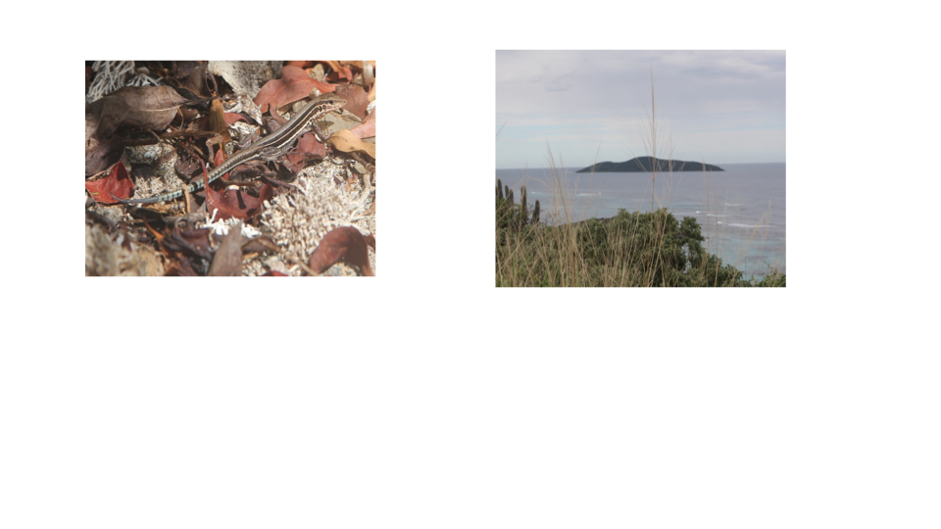
St. Croix ground lizard
57 individuals
Notes:
Example from nuts to soup. Needed abundance of St. Croix ground lizard (that was hard to see) and released by FWS and NPS to make a new population.

Slide 19
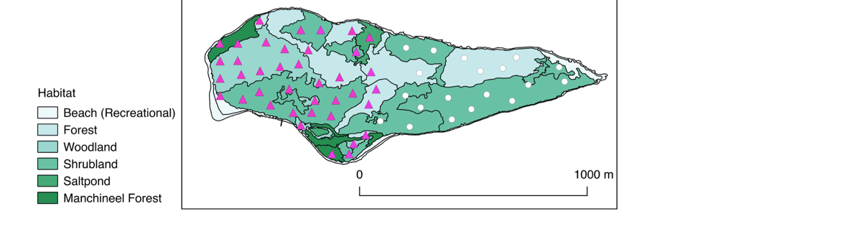
Assumption: Site independence
Site (i) – 42 sites
Survey (j) – 6 surveys
Yi,j –12,900 observations
Each site was >80 m apart
Sites randomly stratified by habitat
Notes:
The sites that we surveyed were for abundance (purple triangles) and occupancy all including white circles.

Slide 20
Assumption: Site closure
Site (i) – 42 sites
Survey (j) – 6 surveys
Yi,j –12,900 observations
Repeated surveys within 4 days
Notes:
The sites that we surveyed were for abundance (purple triangles) and occupancy all including white circles.

Slide 21
Covariates and model selection
Notes:
List the models used
AIC model selection?

Slide 22
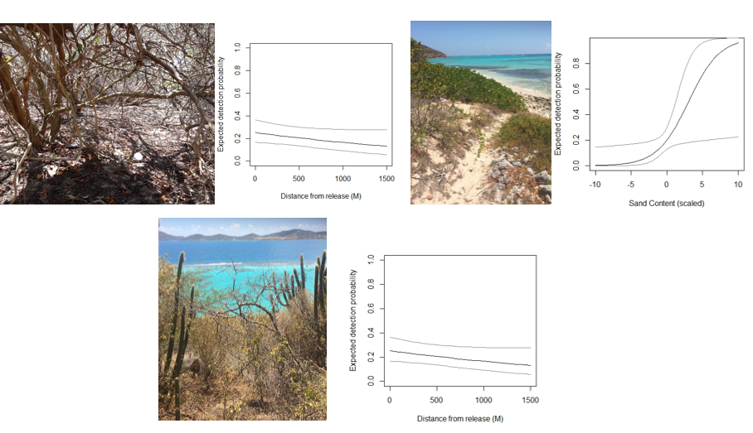
Detection varied among habitat types
Notes:
We found no effect of release site (i.e., greater density) on the lizards in two different kinds of habitat (L) but we did find an effect of sand cover where it is easier to see lizards!!! We found different detection in all of the different types of habitat i.e= if lizards are PRESENT or absent in an density, it was difficult to see them
Because the sites’ detection can co-vary, we can estimate detection across sites based on things that vary between sites.
Here, top right and bottom middle are the different detection rates in shrubland (top) versus woodland (bottom). The detection across sites as it varies by sand is shown in the upper right.

Slide 23
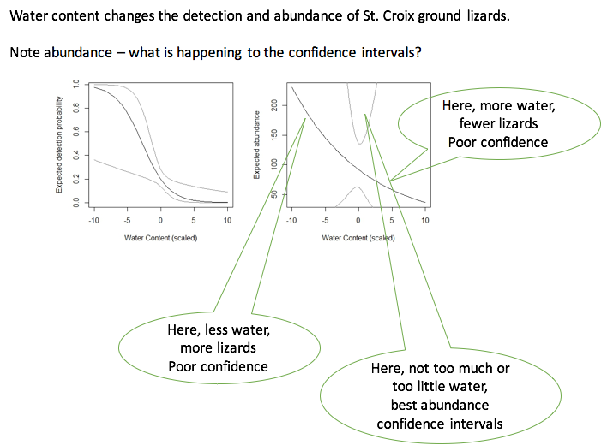
Covariates can aid in understanding species needs
Water content was associated with both detection probability and abundance
What’s going on with the confidence intervals?
Notes:
Water - not significant for final model, but as single covariate

Slide 24
N-mixture models and site-occupancy models
Occupancy and N-mixture models have a lot in common
Sampling design
Assumptions
Mathematical underpinnings
The same dataset could be used in both ways
Collapse all counts into 1 or 0
Occupancy models are the poor man’s abundance
Prioritize N-mixture models if possible

Slide 25
Presence/absence data vs. abundance data were you right?
Example 1: A research conducts point counts for birds in the same forest plot each summer. During point counts, they make an effort to detect and record every species and count the individuals within the survey window.
Example 2: A National Park office often gets reports from people who have seen wolverines in the park. They keep track of the locations and dates of these sights and they send two temp interns to set-up and camera traps randomly throughout the park for two years in a row to capture wolverine on tape.
Example 3: A natural history museum has plant specimens that contain information about the location and date of collection, which can be used to map historical occurrence of the species. Associated field notebooks record the number of total unique plants along the same paths each year for 25 years.

Slide 26
Insert data analysis roadmap here

Slide 28
Extra perspective (optional)
N-mixture models are occupancy models
Model 1: state
z_{i,t} ~ Bernoulli(ψ_{i})
Model 2: observation
y_{i,j,t} ~Bernoulli(z_{i,t}, p_{i,j,t})
Model 1: state
N_{i,t} ~ Poisson(λ_{i})
Model 2: observation
y_{i,j,t} ~Binomial(N_{i}, p_{i,t})
Model 1: state
N_{i,t} ~ Poisson(λ_{i})
Model 2: observation
y_{i,j,t} ~Multinom(N_{i}, f(p_{it}))
MacKenzie et al. (Ecol., 2002); Tyre et al. (Ecol. App., 2003)
Royle & Nichols, (Ecol, 2003)
Royle, (Animal Bio. and Cons, 2004)
Notes:
-N is latent state; data is in y; lambda is abundance; z is the initial state;
-nit is a detection function process
-One application of third type: animal cues like fecal pellets can be assessed when instead of multinomial poisson is used for observation process
AMT- I think this slide is great but too much detail

